Slide 1
Collective Leadership: What is It, Why is It Important, and How Can You Build Capacity for It?
Presented By: Cassandra O’Neill
Powered By:

Slide 2
Collective Leadership: What Does it Mean for You?
This is for you if:
You are excited about bringing in more voices, sharing responsibility, maximizing potential and having everyone working toward a common goal with enthusiasm.
You are tired of talking/hearing about the “lack of leadership” and want to be part of the solution.
You are tired of feeling like you are doing all the work, and are ready to inspire others to step up their leadership so the whole group benefits, and you get more joy back at work.

Slide 3
Collective Leadership: What Does it Mean for You?
Webinar Learning Objectives:
Understand:
Fundamentals of Collective Leadership
6 Elements of Collective Leadership
Be familiar with the differences between:
Individual Leadership
Collective Leadership
Learn about resources for:
Self-assessment
Capacity building of Collective Leadership

Slide 4
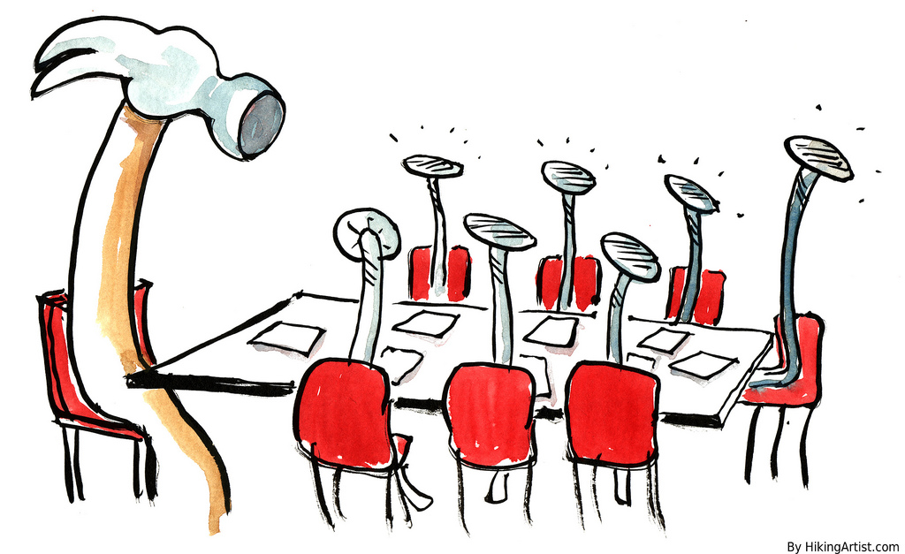
What it isn’t – Old ideas about leadership
Command and Control
Hierarchy
Higher-ups make decisions
Top Down

Slide 5
What it isn’t – Old ideas about leadership
Small number of “leaders”(everyone else is defined as a follower)
Old views about people – that they need to be told what to do
Organizations are machines

Slide 6
Definitions
Collective Leadership
Sometimes called Shared or Distributed Leadership
Related to Self-Managing Teams

Slide 7
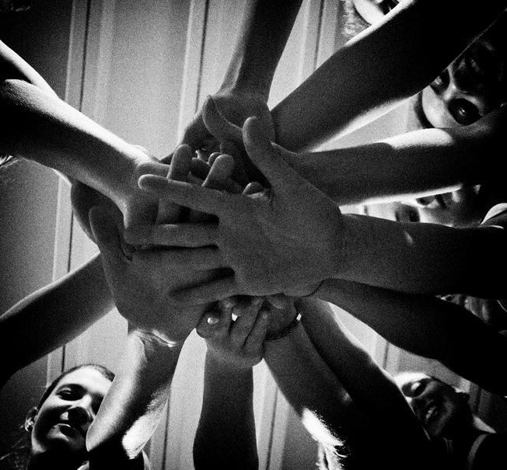
How Can Collective Leadership Be Used?
In a Team
In a Program
Across an Organization *
Within a Board of Directors
Multi-Organizational Collaborations
Collective Impact Initiatives
* Shared Leadership found to be one of the 6 practices of High Impact Nonprofits in the book Forces for Good

Slide 8
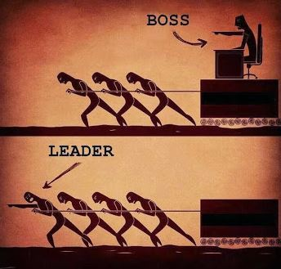
Why? What are the Benefits?
More productivity from teams
Increase impact of organization
Sustainable Leadership – not dependent on 1 person
Community or System Change Goal so large that only achievable by multiple organization’s working together toward shared goal i.e. Collective Impact
Create unstoppable teams who deliver ambitious results

Slide 9
Collective Leadership – It’s a ‘Both/And’ not an ‘Either/Or’
Not all or nothing - an organization can have some classical and some collective leadership
Can move a group from more traditional leadership model to Collective Leadership over time
Can start a new group with some or all of the elements

Slide 10
Classical vs Collective Leadership
Classical Leadership | Collective Leadership
Displayed by a person’s position in a group or hierarchy. | Identified by the quality of people’s interactions rather than their position.
Leadership evaluated by whether the leader solves problems. | Leadership evaluated by how people are working together.
Leaders provide solutions and answers. | All work to enhance the process and to make it more fulfilling.
Distinct differences between leaders and followers: character, skill, etc. | People are interdependent. All are active participants in the process of leadership.
Communication is often formal. | Communication is crucial with a stress on conversation.
Can often rely on secrecy, deception and payoffs. | Values democratic processes, honesty and shared ethics. Seeks a common good.
Drawing from material in Gloria Nemerowicz and Eugene Rosi (1997) Education for Leadership and
Social Responsibility, London: Falmer Press. Page 16.

Slide 11
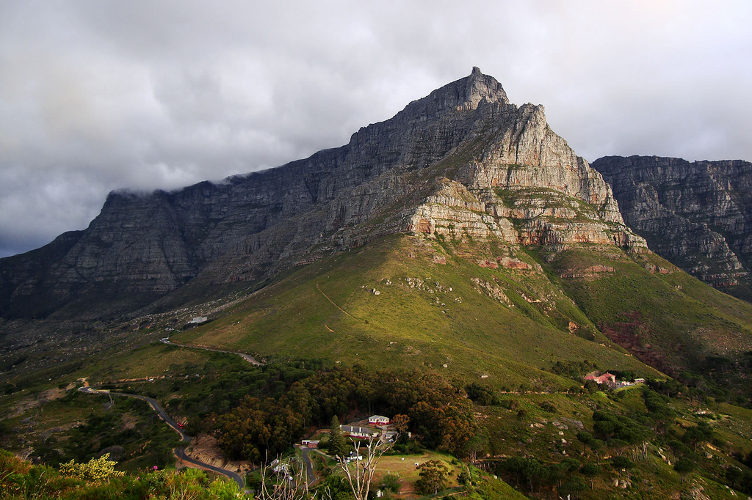
A metaphor
Climbing a mountain

Slide 12
Where are you? Poll:
Are you already involved in a group that is using elements of Collective leadership?
Are you thinking about how to maximize the potential of your team or organization through adoption of Collective Leadership?
Are you involved with others in thinking about starting a multi-organizational effort that could benefit from Collective Leadership?
Are you involved in a multi-organizational effort, i.e. a collaboration or Collective Impact initiative?

Slide 13
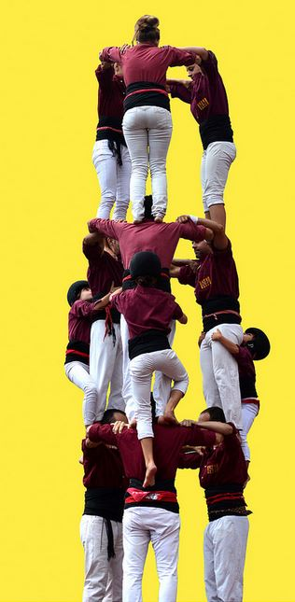
6 Elements of Collective Leadership:
Identify Shared Goals
Structures and Processes for Shared Decision Making
Identify and Build on Strengths

Slide 14
6 Elements of Collective Leadership:
Rotating and Sharing Roles so Team Members Can Activate Their Gifts
The Whole is Greater Than the Sum of the Parts: Accessing Collective Intelligence
Best Practices for Organizational Effectiveness

Slide 15
Q and A

Slide 16
What Does
This Look Like?

Slide 17
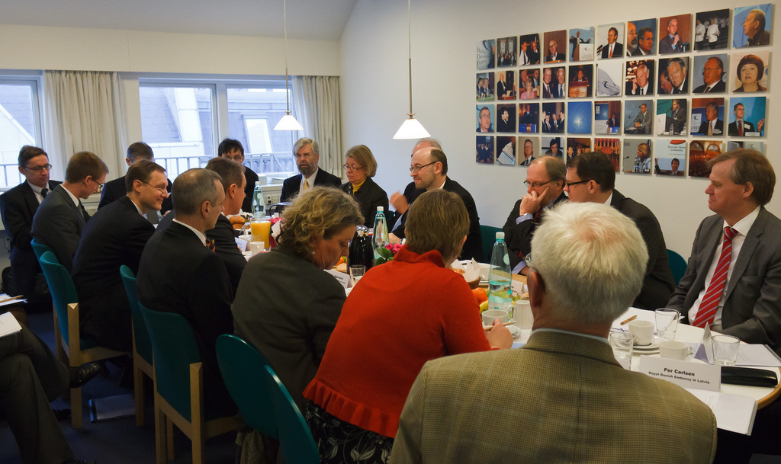
Examples:
New Coalition in Rural County – started with Collective Leadership
Existing Group Exploring making Changes – Barriers with existing structures
A. Board of Directors
B. Coalition

Slide 18
Assess Skills and Interests of Group Members

Slide 19
Some Assessment Tools
Strengthsfinder 2.0
Emotional Intelligence 2.0
Assessment in the book Developing a Learning Culture in Nonprofit Organizations
Collective Leadership Assessment http://www.stakeholderdialogues.net/learning/toolbox/collective-leadership-self-assessment/

Slide 20
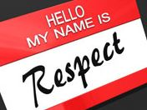
Two types of Conflict
1. Affective Conflict:
Personalized confrontation
Destructive to relationships and teamwork

Slide 21
Two types of Conflict
2. Cognitive Conflict:
Focuses on issues and ideas
A respectful exchange and exploration of differing and alternative views
Goal is to anticipate consequences and make the best possible decisions
Cognitive conflict is critical for healthy groups
From the book The OIQ Factor: Raising your school’s organizational intelligence --How schools can become cognitively, socially, and emotional smart.

Slide 22
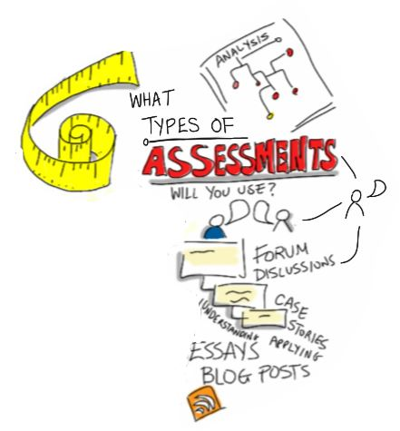
Assess Conflict Styles
Individual Assessment
Style Matters http://www.riverhouseepress.com/
Organizational Assessment
http://www.conflictclimate.com/

Slide 23
Assess and Reflect on Process of Your Group
Assess Meetings
Pluses and Wishes
Sample meeting evaluation tool in the book Developing a Learning Culture in Nonprofit Organizations

Slide 24
Assess and Reflect on Process of Your Group
Assess how the group is working together toward goals – Annually or Semi-Annually
Options:
Use Wilder Collaboration Assessment - http://wilderresearch.org/tools/cfi/index.php
Make your own assessment

Slide 25
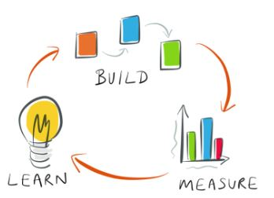
Assess and Reflect on Process of Your Group
One idea for maximizing these types of assessments:
Instead of people filling out a survey and looking at the results - you can do the assessment interactively.
Use flashcards with a scale like:
Not at all, Sometimes, All the time

Slide 26
Assess and Reflect on Process of Your Group
Read a statement
Example: Our collaborating partners
have the same vision for young children.
Group holds up flashcards
Discussion
Re-vote
Then Record Results

Slide 27
Decision Making
What is the decision?
Who is involved?
How are they involved?
There is often very little clarity on the answers to these questions.
Issue # 1 What Kind of Decision is it?

Slide 29
A Tool: The Decision Making Matrix
A decision making matrix allows for an organization or team to list the key decisions that are being made and clarify who is:
Responsible for making the decision,
Who has authority to Approve or Veto,
Who should be Consulted,
Who should be Informed, and
Who will Support the implementation of the decision.

Slide 30
Decision Making Matrix
Decision Making MATRIX (sample organization)
R=Responsible (for making the decision); A or V = (right to veto); C=Consult (those whose advice/opinions are needed to make decision); I=Inform (those whom are kept updated); S= Supports (those implementing decision)
Decision | Board | Executive Director/ CEO | COO | Department Director |  | Caseworker | Volunteer Tutors
How to do annual strategic planning | R | R | C | C | I |  | I
What grants to apply for | I | R | R | R | S |  | S
What fundraising to do | I | R | C | C | I |  | I
What eligibility requirements are for participants | I | R | C | C | C/S |  | C/S
How to best provide support services | I | R | C/S | C/S | C/S |  | C/S

Slide 31
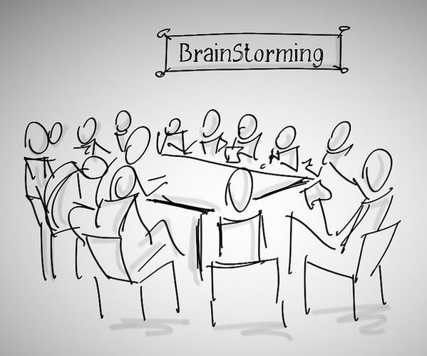
Decision Making Process
One example: The Focusing Four Process
Step 1: Brainstorm
Step 2: Clarify
Step 3: Advocate
Step 4: Canvass
Video to purchase http://www.thinkingcollaborative.com

Slide 32
Resources
Facilitator’s Guide to Participatory Decision Making by Sam Kaner – http://communityatwork.com/
Decisive – by Chip and Dan Heath
http://heathbrothers.com/
Liberating Structures: http://www.liberatingstructures.com/

Slide 33
Resources
Reinventing Organizations: A Guide to Creating Organizations Inspired by the Next Stage of Human Consciousness by Frederic Laloux
Life Cycle Assessment: Five Life Stages of Nonprofit Organizations by Judith Sharken Simon
Is there an Emotional Vampire on Your Team? Free audio available at http://bethebestbossever.com/id-vampires/

Slide 34
Q and A

Slide 35
3 Capacities Identified in Recent SSIR Article: The Dawn of System Leadership
Helping people see the larger system of which they are a part of.
Fostering reflection and more generative conversations than can result in truly innovative solutions.
Shifting the collective focus from reactive problem solving to co-creating the future.
http://www.ssireview.org/articles/entry/the_dawn_of_system_leadership

Slide 36
Wrap-up and Resources
www.wholonomyconsulting.com Collective Leadership Page

Slide 37
Contact Information
Cassandra O’Neill
Email: cassandraoneill@comcast.net
Phone: (520) 403-0687
Website: www.wholonomyconsulting.com

Slide 38
Interested in a 1:1 consultation with Cassandra?

Slide 39
Produced By
Society for Nonprofits
PO Box 510354
Livonia, MI 48151
Email: info@snpo.org
Web: www.snpo.org
Phone: 734-451-3582 | Fax: 734-451-5935
Powered By:

